Slide 1
Costa Mesa
Pension Oversight Committee
Council Update
February 4, 2014
Website: http://www.costamesaca.gov/index.aspx?page=1603

Slide 2
Overview
- POC Committee Activities
- Costa Mesa Pension Plans
- PERS Information
- PERS Actuary Presentation
- Options
- Supplemental Materials

Slide 3
Committee Activities
-Studied and presented each benefit plan
-Studied legal and accounting environment
-Review current events, local and across the country
-Researching and analyzing possible option(s)

Slide 4
“Classic” Employees’ PERS Plan Formulas
Police: 3% at age 50
Fire: 3% at age 50
Miscellaneous: 2.5% at age 55
Most “Classic” employees were hired before PEPRA reform 1/1/2013
Source: Costa Mesa Human Resources

Slide 5
What does 3% at 50 mean?
Years of Service X
Benefit Factor (3% at age 50) X
Final Compensation (12 highest months) =
Pension + 2% Annual COLA
Example:
25 Years X 3% Factor X $100,000 =
$75,000 Pension + COLA

Slide 6
“Classic” Employees’
PERS Contribution Rates
Police: 5.0%
Fire: 5.0%
Miscellaneous: 8.52%
Source: Costa Mesa Human Resources

Slide 7
Source: Costa Mesa Human Resources

Slide 8
Costa Mesa Unfunded Liability
6/30/12: $228 million latest valuation
62% funded
6/30/11: $196 million
66% funded
- Liability increased $32 million
- Funded percentage dropped 4% pts
Source: CalPERS

Slide 9
Costa Mesa Unfunded Pension Liabilities

Slide 10
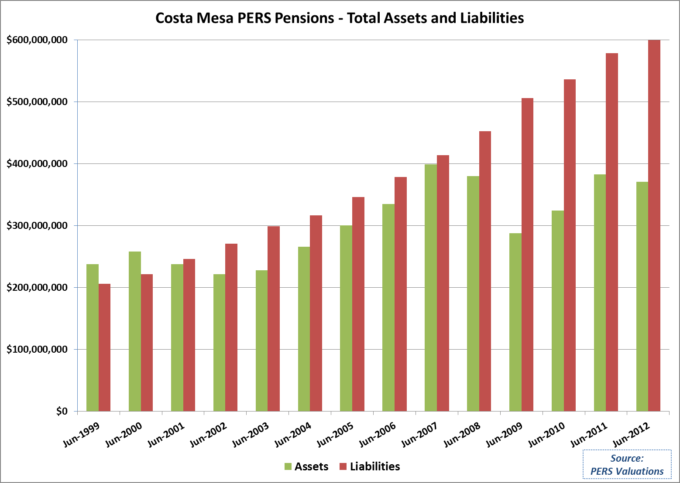

Slide 11
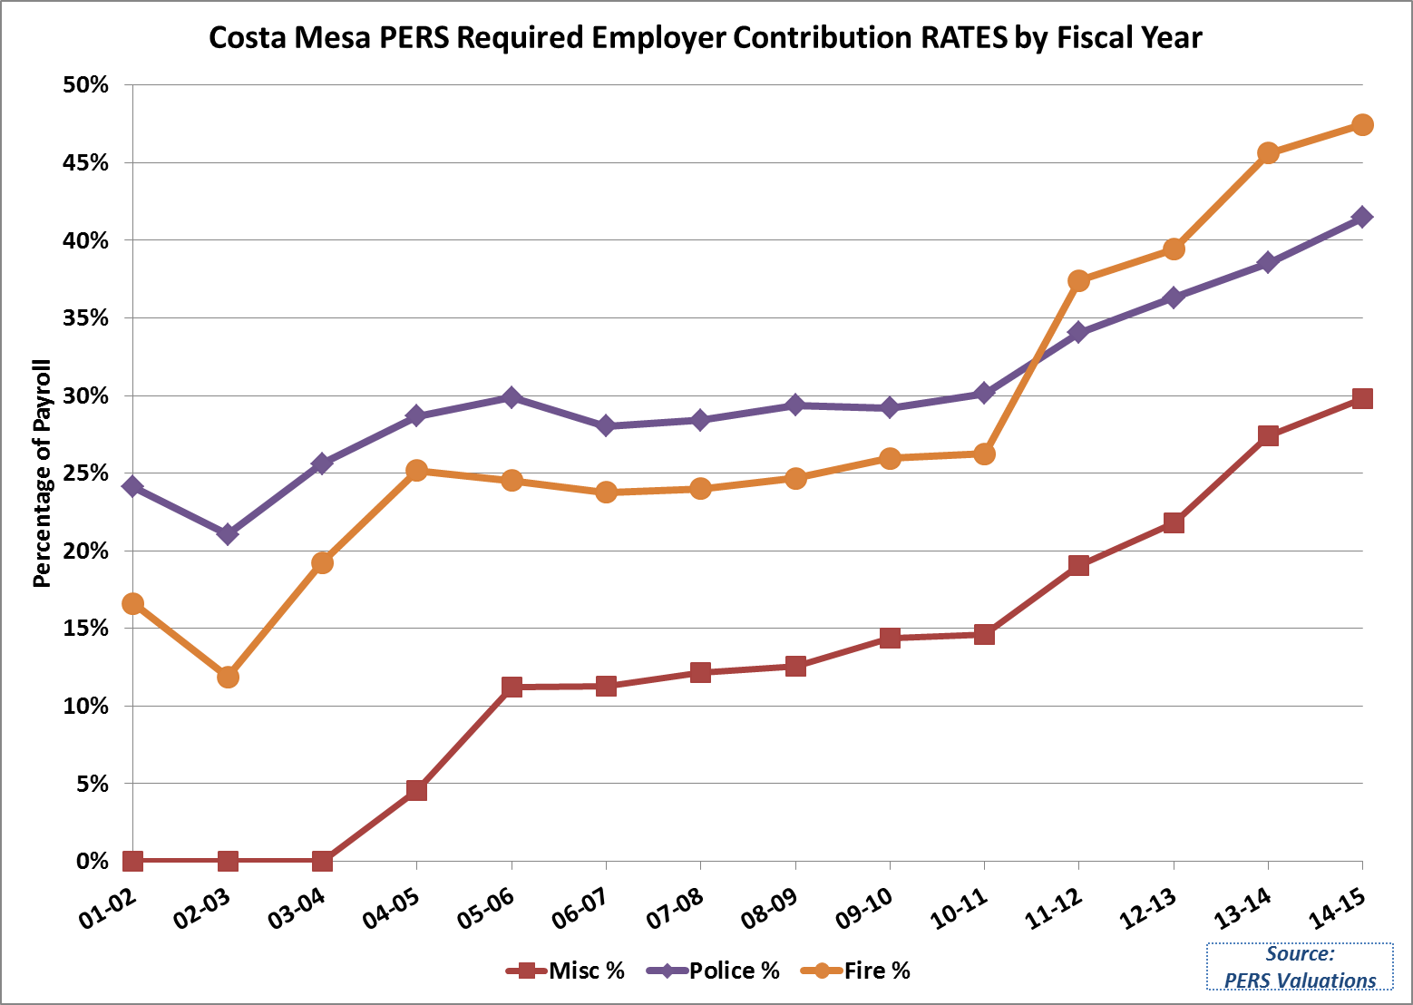

Slide 12
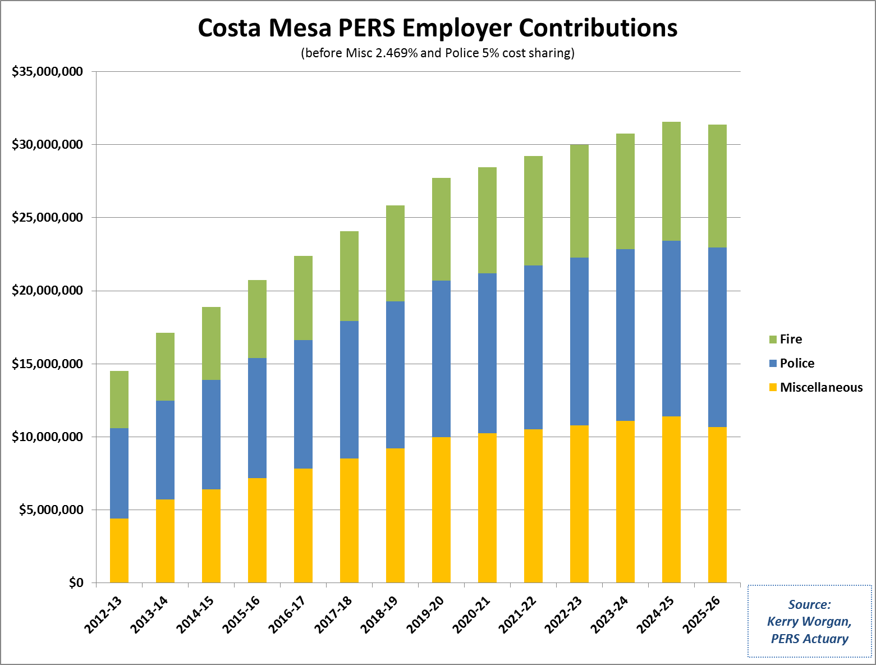

Slide 13
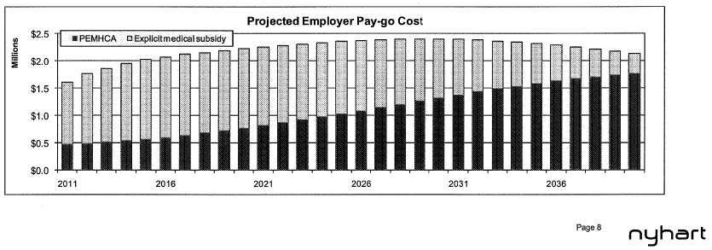
Retiree Medical
(Other Post Employment Benefits,OPEB)
Pay-go Annual Costs:
$1.6 Million in 2011-12
$2.3 Million in 2021-22

Slide 14
Costa Mesa Pension Costs as % of General Fund
Fiscal Year | 2002-03 | 2007-08 | 2012-13 | 2017-18* | 2022-23*
General Fund | $ 82 | $ 103 | $ 103 | $ 119 | $ 138
Pension Costs | $ 8 | $ 14 | $ 15 | $ 24 | $ 30
Pension Cost as % of General Fund | 9.8% | 13.6% | 14.6% | 20.2% | 21.7%
$ in millions
* General Fund assumed to increase 3% per year

Slide 15
Summary
In 10 years, city has seen unprecedented increase in unfunded liability
In next 10 years, pension payments will increase significantly
In next 10 years, pension payments will not decrease unfunded
City has limited options to make progress or implement changes

Slide 16
PERS Information
Members:
- Active and Inactive 1.1 million
- Benefit Recipients 0.6 million
- TOTAL MEMBERS 1.7 million
Source: CalPERS 2012-13 CAFR, PERF

Slide 17
Source: Joe Nation’s report to CM

Slide 18
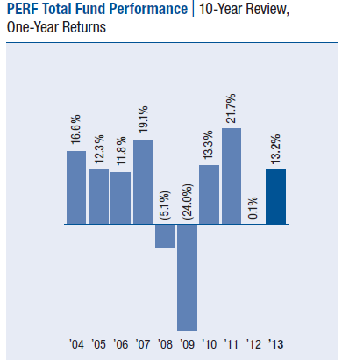
PERS Investment Returns
- Annual Target 7.5%
- FYE 6/30/2012 0.1% latest valuation
- FYE 6/30/2013 13.2%
Source: CalPERS 2012-13 CAFR

Slide 19
CalPERS Unfunded Liability
6/30/12: $104 billion
70% funded
6/30/11: $ 87 billion
74% funded
- Liability increased $17 billion
- Funded percentage dropped 4% pts
Source: CalPERS 2012-13 CAFR, PERF

Slide 20
PERS Actuary Presentation
See the Video:
http://costamesa.granicus.com/MediaPlayer.php?view_id=10&clip_id=2260

Slide 21
Pension Oversight Committee
Valuation Report Update
City of Costa Mesa
November 20, 2013
Kerry Worgan FSA, FCIA
Senior Pension Actuary, CalPERS

Slide 22
Projected Contributions – Miscellaneous Plan

Slide 23
Projected Contributions – Safety Police Plan

Slide 24
Projected Funded Status – Miscellaneous Plan

Slide 25
Projected Funded Status – Safety Police Plan

Slide 26
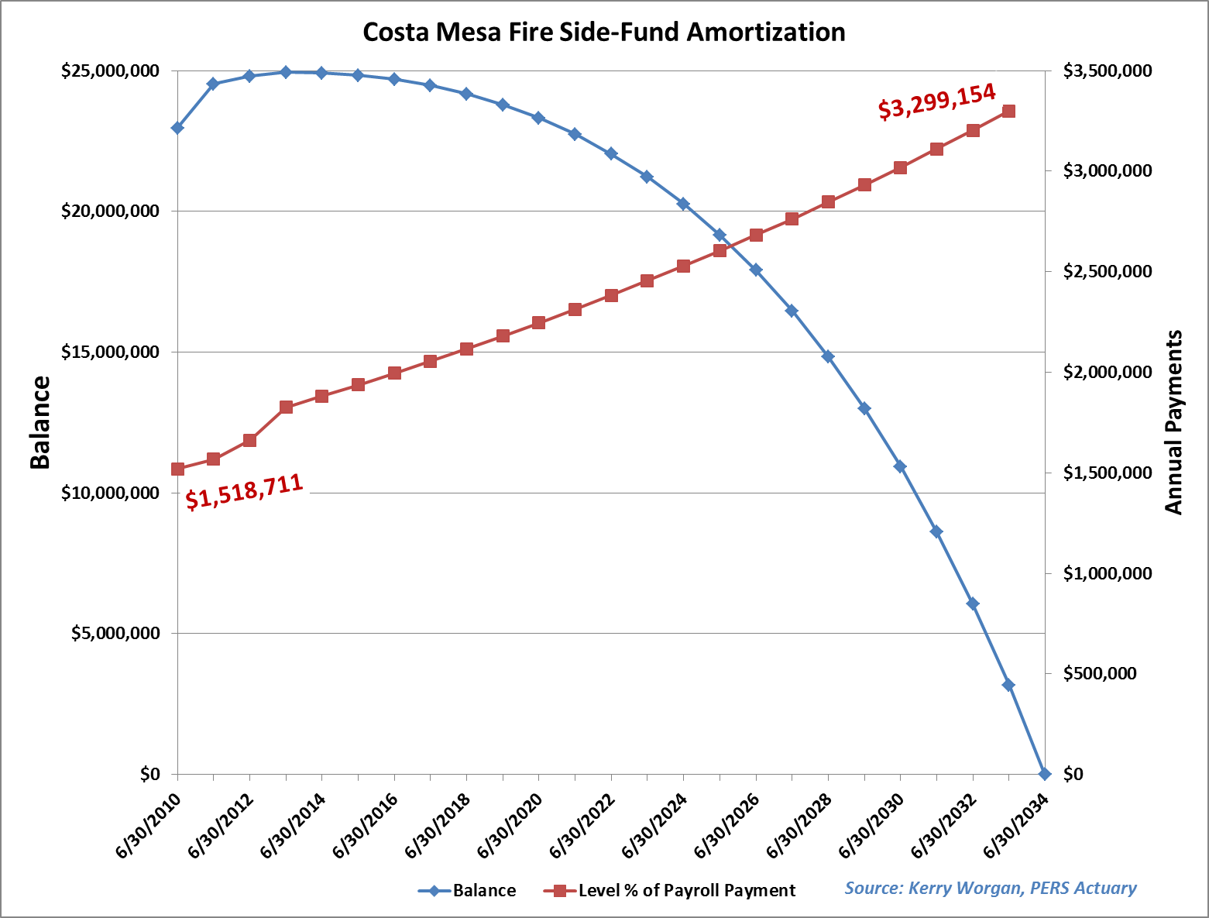

Slide 27
Guiding Principles
To be successful, Costa Mesa’s leadership groups: government, employees, and citizens should unite on reform solutions.
All groups will likely share in the cost of reform.

Slide 28
Options
Three Levels of Control
- City Implementation
- City and Labor Associations
- California and CalPERS

Slide 29
Options
- City Implementation
Re-combine Fire and Police plans into one Safety plan. Eliminate any risk Fire funds might have in a multi-agency risk pool.
Increase revenue/funds to pay Unfunded Liabilities:
Raise Taxes: sales tax, property tax, or parcel tax.
Sell/Lease Assets: e.g. Civic Center, Fairview Parks
Borrow: Issue pension bonds
Allocate general funds over and above annual PERS required contributions.
Decrease City Services

Slide 30
Options
-City Implementation
Recommendations
See Interim Finance Director proposal
Pay down Fire side-fund
If Cost of Money is less than 7.5% PERS rate of return for Fire side-fund
Use $1,000,000 already earmarked for PERS
Make annual lump-sum prepay(s)
Annual lump-sum PERS Prepays ~ 3.55% discount, cash flow permitting
Review progress annually

Slide 31
Options
-City and Labor Associations
Negotiate increased employee contributions
Negotiate reduced “Optional” PERS benefits
Negotiate compensation changes to offset PERS costs

Slide 32
Options
-California and CalPERS
California Rule does not permit Pension benefit reductions presently
Join with other agencies to advocate reforms in Sacramento

Slide 33
Next Steps
- Engage PERS and OPEB actuaries
Calculate what-if scenarios
Calculate future costs and savings
- Engage and educate Citizens
- Engage and educate Employees

Slide 34
Want to Know More?
- Read the Report
- Read the Supplemental Slides
- Visit POC website:
http://www.costamesaca.gov/index.aspx?page=1603
- Visit CalPERS website:
http://www.calpers.ca.gov

Slide 35
Questions?

Slide 36
Supplemental
Materials

Slide 37
Consumer Loan Amortization
Versus
PERS Level Percent of
Payroll Amortization

Slide 38
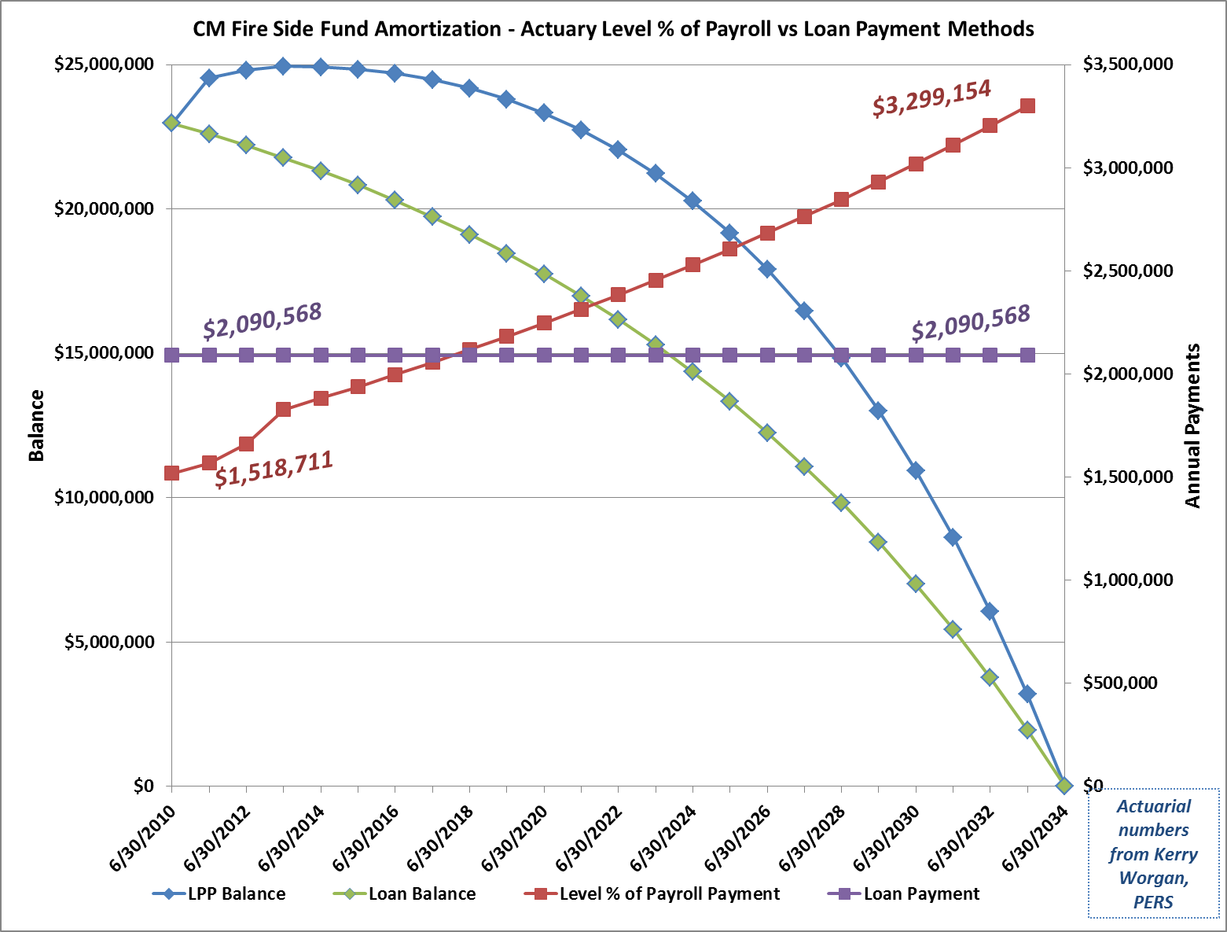

Slide 39
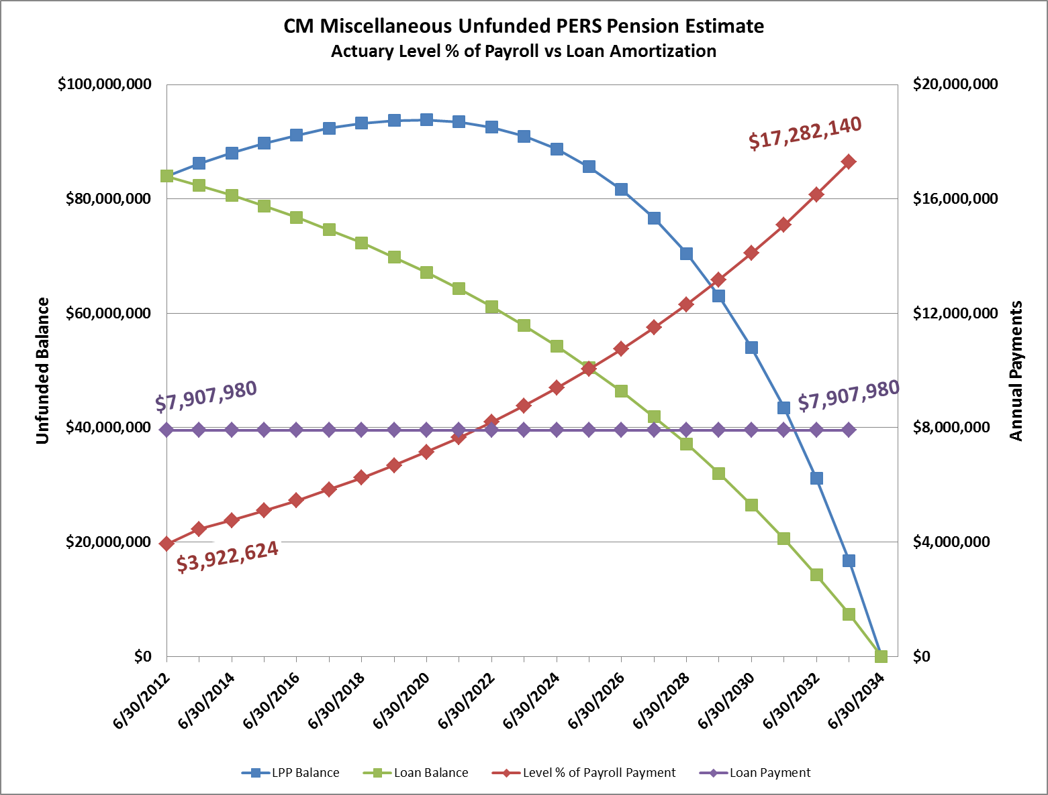

Slide 40
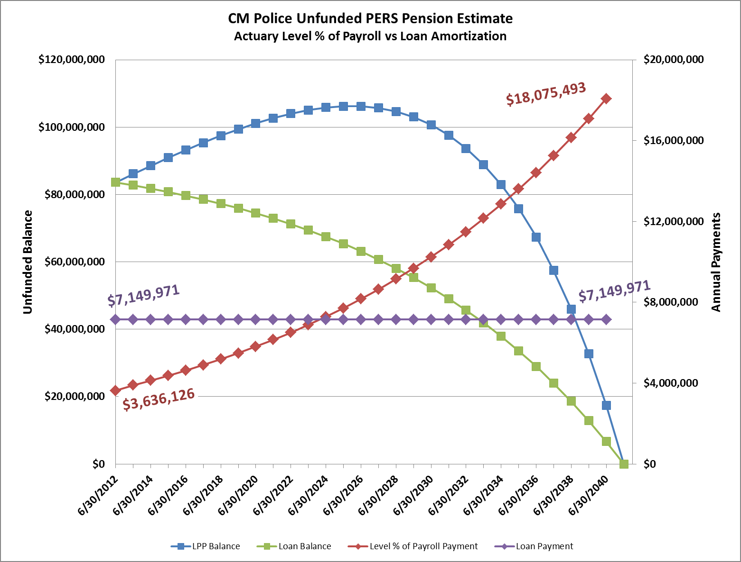

Slide 41
Source:
CM Human
Resources

Slide 43
Committee Activities
-Studied and presented each benefit plan
Police PERS pension
Fire Side fund and 3%@50 Risk Pool PERS pension
Miscellaneous PERS pension
Retiree Medical plan
Police 1% Supplemental plan

Slide 44
Committee Activities
-Studied legal and accounting environment
Public Employees’ Pension Reform Act of 2013 (PEPRA)
New Governmental Accounting Standards Board (GASB) standards 67 & 68.
  Impact of accounting for pensions more like private sector FASB rules
Costa Mesa Budgets
Costa Mesa Comprehensive Annual Financial Report (CAFR)
Brown Act (twice)
Costa Mesa Civic Openness In Negotiation (COIN) act
Municipal Bankruptcy law
City attorney Kim Barlow opinion on safety of Costa Mesa assets in PERS
Joe Nation, Stanford Institute Economic Policy Research presentation 2/26/13
Impact of Miscellaneous 2.5%@55 benefit increase presentation 2/26/13
OC Local Agency Formation Committee Fiscal Trend Analysis http://www.oclafco.org

Slide 45
Committee Activities
-Review current events, local and across the country
Stockton and San Bernardino Bankruptcies
  CalPERS and City viewpoints
Out of state bankruptcies – Detroit, etc.
Out of state Pension Reforms
  Rhode Island
  Illinois
  Lexington KY
  Etc.

Slide 46
Committee Activities
-Researching and analyzing possible action(s)
Prepared and refined 57 questions for staff and actuaries (June 5 – Aug 21)
  CalPERS actuary, Kerry Worgan, presentation November 20, 2013
    Follow up questions for Kerry Worgan
PERS annual lump-sum pre-pay option savings
Pre-Pay Fire side-fund
Regular long-term PERS pre-payment to amortize unfunded liabilities earlier
  Property and Sales Tax increases
  Pension obligation bond
Contacted local cities about their PERS payment plans
  Laguna Hills – paid off $565K Miscellaneous side fund. LH uses OC Fire and Sheriff
  Irvine – prepaying Police unfunded, subject to annual review. Irvine uses OC Fire
  Huntington Beach – prepaying multiple unfunded liabilities

Slide 47
Options
-City and Labor Associations
Employees pay their full contribution rate allowable by State law.
Employees pay a portion of the City’s share so employee contributions equal at least one third of the total contribution rate.
Employee contribution rates increase or decrease in conjunction with the total contribution rate. If rates increase employees pay additional if it decreases employees pay less just like the City.
Initiate some form of (non pensionable) performance sharing versus pensionable salary increases. In other words, split annual increases between pensionable and annual (and non necessarily recurring) non pensionable payments.
Negotiate a 36 month final compensation period to use for calculating pension amounts.
Negotiate flexible COLA options such as:
  every other year adjustments
  different percentage options
  suspension of COLA’s until specific financial metrics are achieved by the City

Slide 48
Options
-California and CalPERS
Some possible reforms at the state level are: (there are undoubtedly more)
Add a 3 year final compensation base option for cities to use to calculate pension amounts.
Narrow the definition of pensionable compensation to exclude special reimbursable allowances.
Prohibit retroactive pension increases (PEPRA)
Permit cities to allow some or all employees to participate in Social Security.
Provide more retirement benefit options for cities/agencies to use for contract negotiations.
Adjustments to existing pensions for retirees who received retroactive pension formula improvements within 5 – 10 years of retirement.
Approval for cities/agencies to make COLA adjustments depending on their financial status.

Slide 50
ACTO Update
Demographic Assumption Changes
- Experience Study underway (salary, mortality, retirement, termination)
- Mortality improvement assumption
- Recommendations to Board in Feb 2014
- Impact on Valuation at 6.30.2013

Slide 51
Schedule of Amortization Bases
Unfunded Liability broken down by source
  Assumption/Method changes (20 years)
  Benefit changes/Amendments (20 years)
  Gains and Losses (rolling 30 year)
  Special Gains and Losses (fixed and declining 30 year) for 2009, 2010, and 2011 valuations

